Slide 1
The PokéCenter:
a Salesforce Org
Created by:
Joshua Scilex

Slide 2
AGENDA
>
>
>
>
>
>
Requirements
Process
Implementation
Tour
Going Forward
Pass it on!

Slide 3
REQUIREMENTS
Customer qualification system
Location-specific products
Promotional rewards system

Slide 4
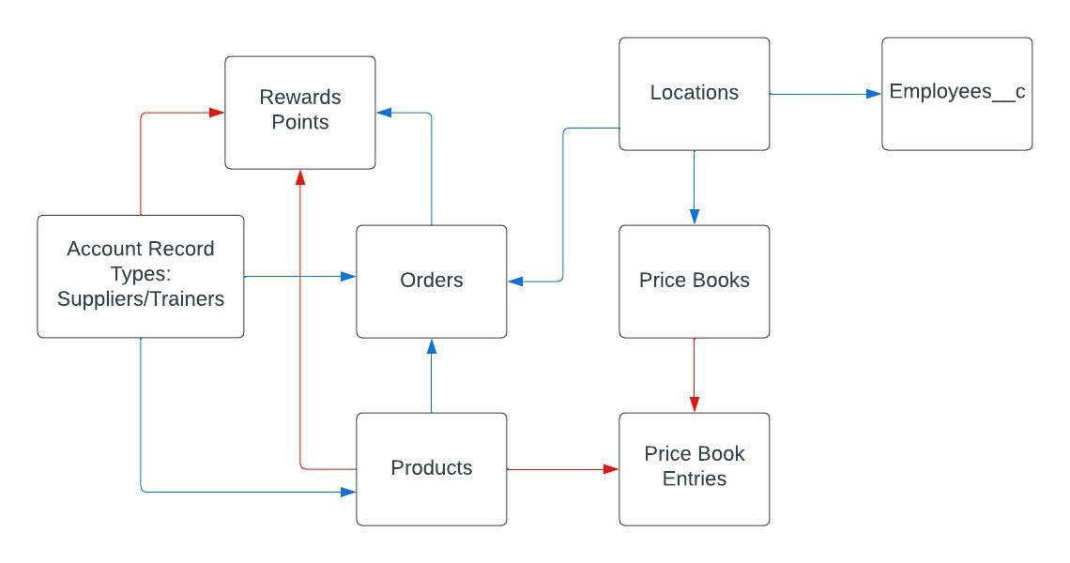
PROCESS
ScrumBan
TrailHead
ERD

Slide 5
IMPLEMENTATION
Data Loader
Lookup & Master/Detail Relationships
Process Automation

Slide 6
TOUR

Slide 7
GOING FORWARD
Future Features
Populate more data
Debug Flows
Further UI Configuration

Slide 8
THANKS!

